Slide 1



Streamlyne:
IRB Protocol Module
For Researchers
CCCUPR IRB

Slide 2
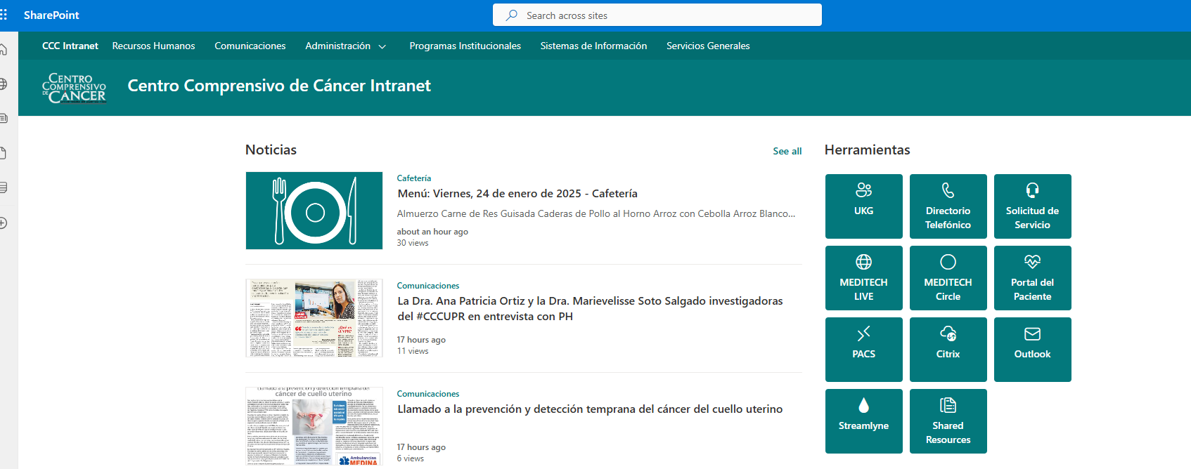
Intranet: https://cccuprnet.sharepoint.com/sites/webintranet

Slide 3
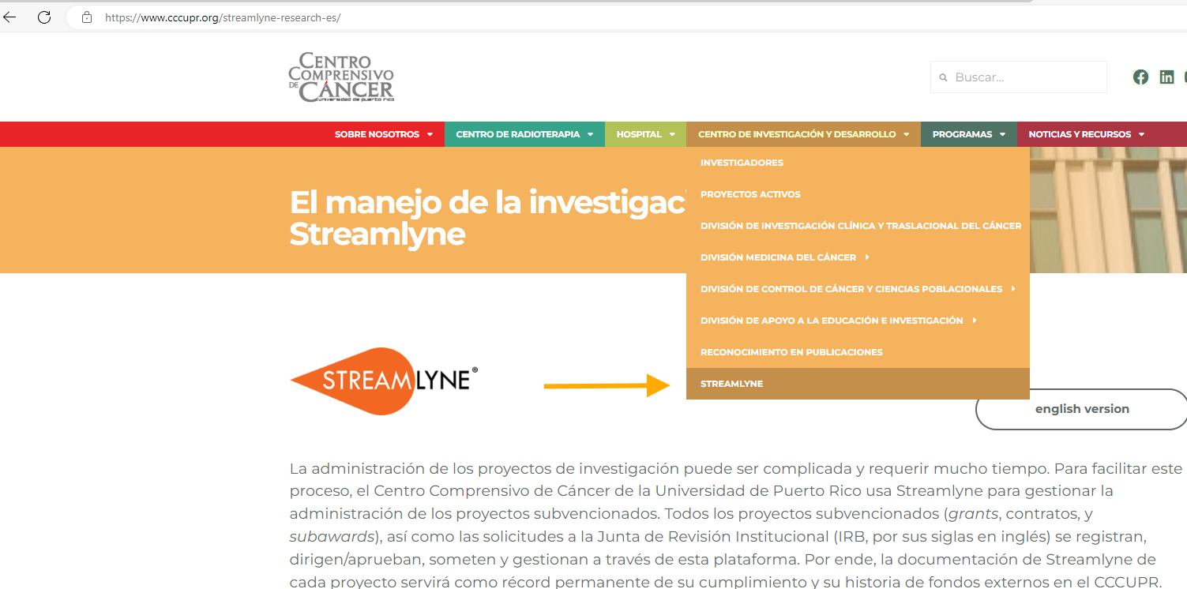
Go to : https://www.cccupr.org/

Slide 4
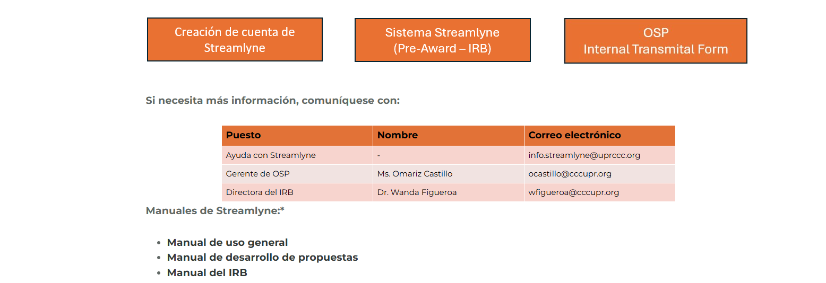
Download manuals in pdf

Slide 5
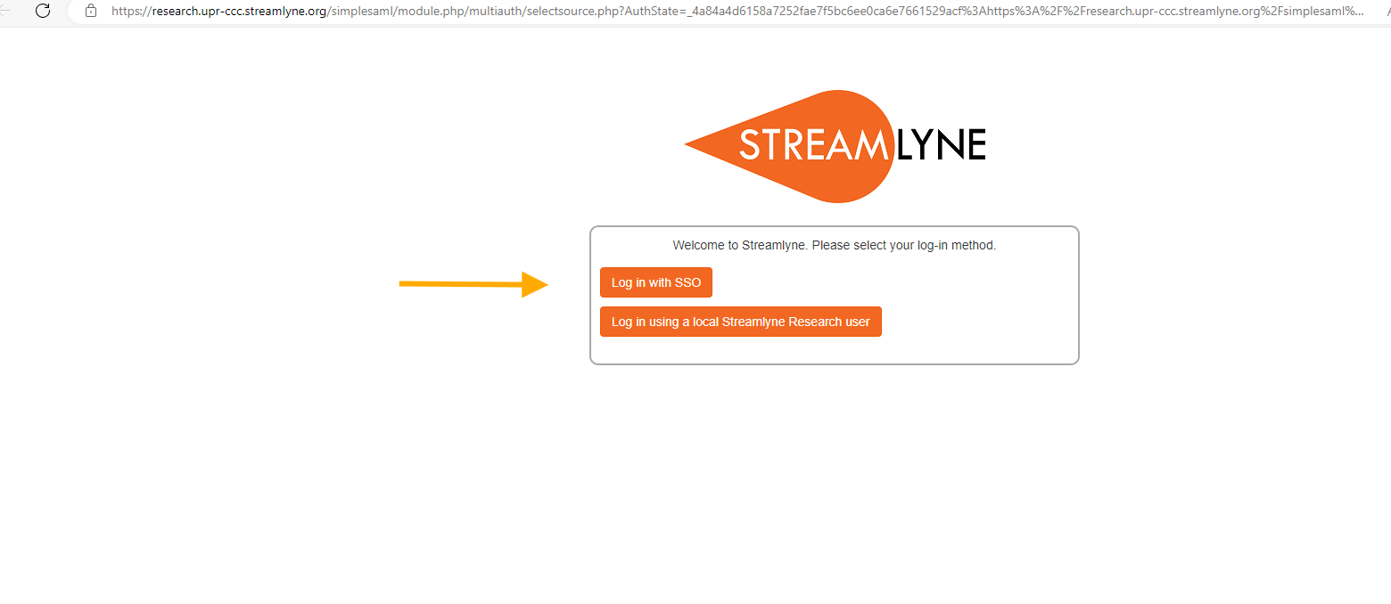
If you have the CCC credentials you can log in with SSO.

Slide 6
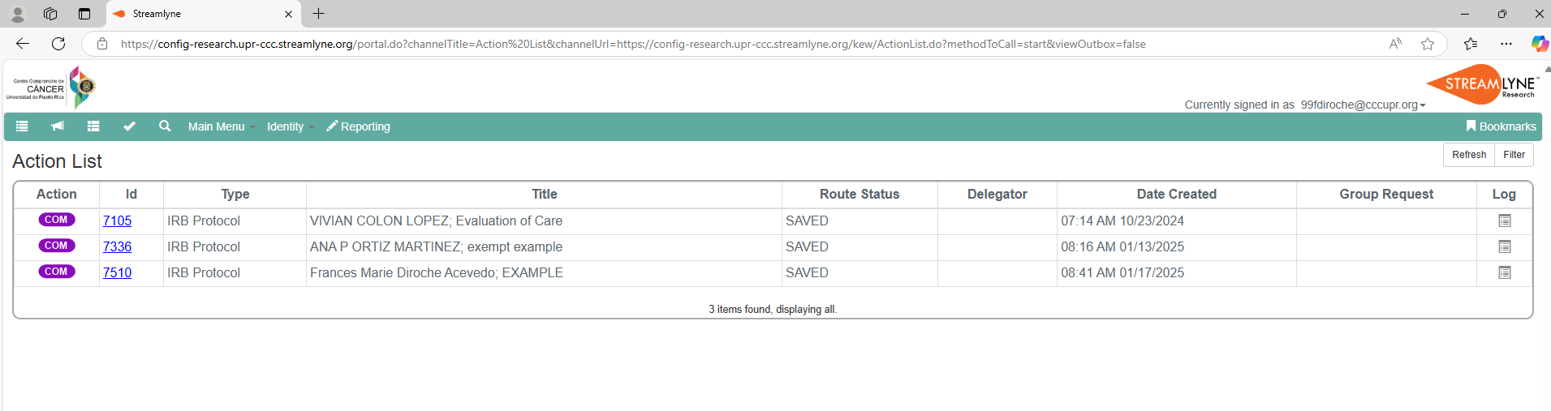
Action List:
This section displays the list of protocols initiated by the Principal Investigator (PI). It also appears in the action list for each of the study personnel.

Slide 7
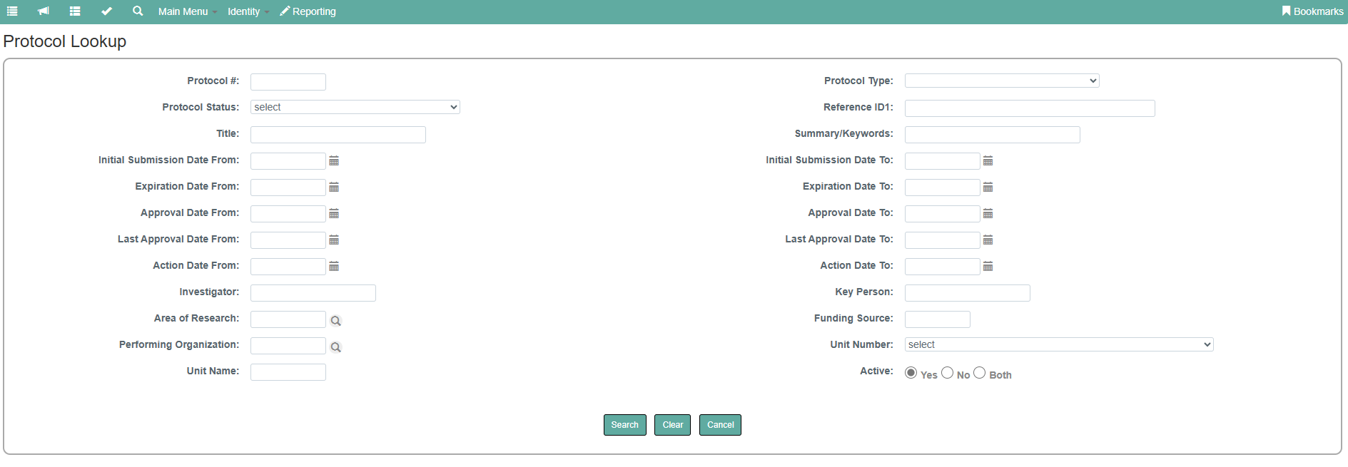
In this section all the protocols will be listed below the Protocol Lookup search bar.

Slide 8
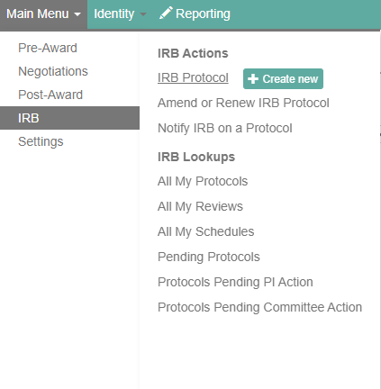
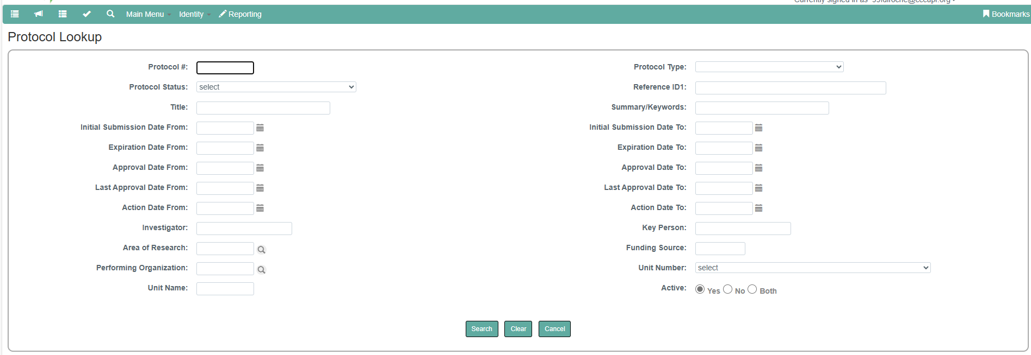
New protocol number
*last 4 digits of Protocol number*
“*” It will display the list of all the protocols.
Title of the Study
Name * or Last name *

Slide 9
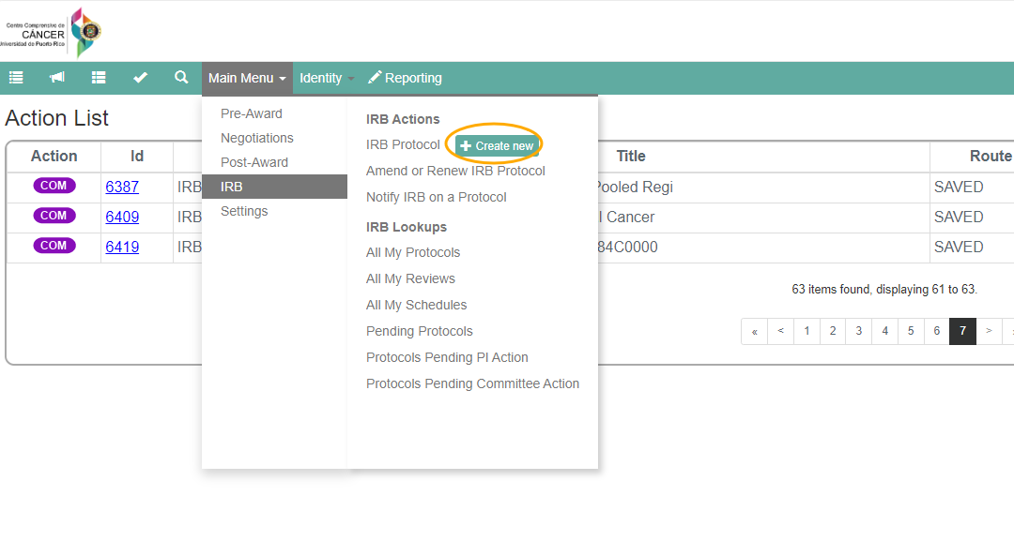
Initiating & Submitting a New Protocol
Main Menu> IRB> + Create New

Slide 10
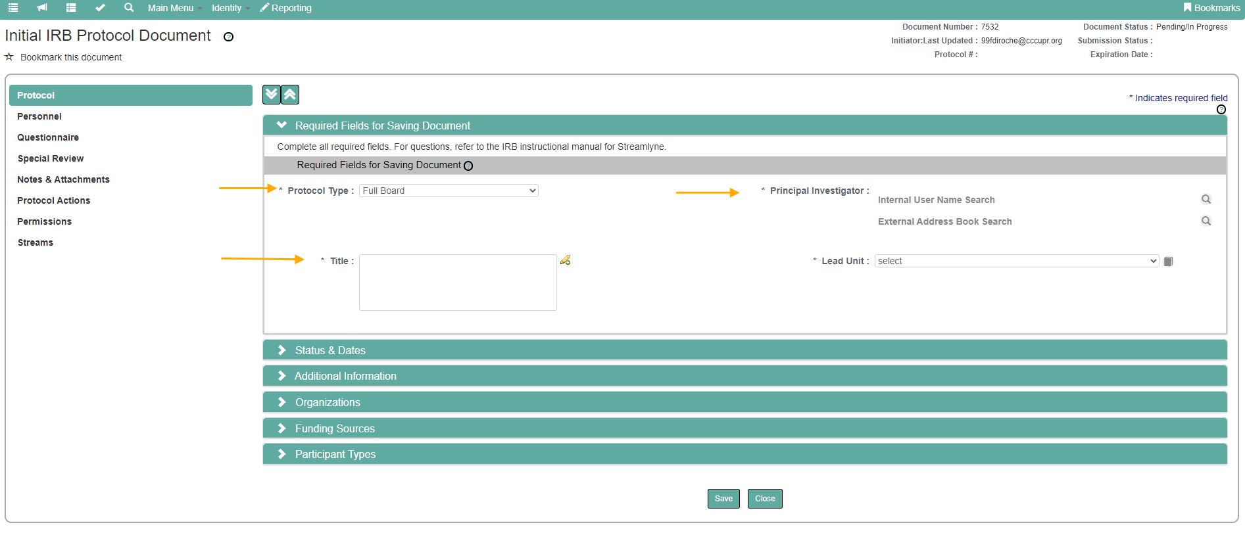
Protocol Tab > Required Fields for Saving Document
Search for internal or external PI
Complete these 3 required fields

Slide 11
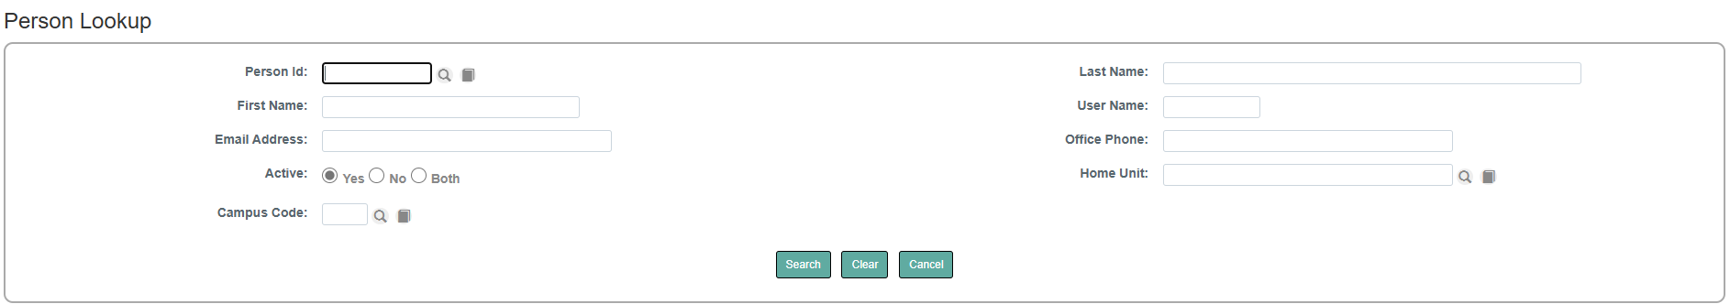
Internal username search: Personnel Affiliated to CCC.
Person ID number (generated by the platform)
Last name *
First name*
Click return value to populate the PI

Slide 12

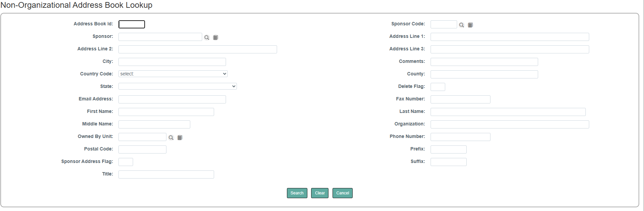
External Address Book Search: Personnel Non-Affiliated to CCC.
Address Book ID (generated by the platform)
First name*
Last name *

Slide 13
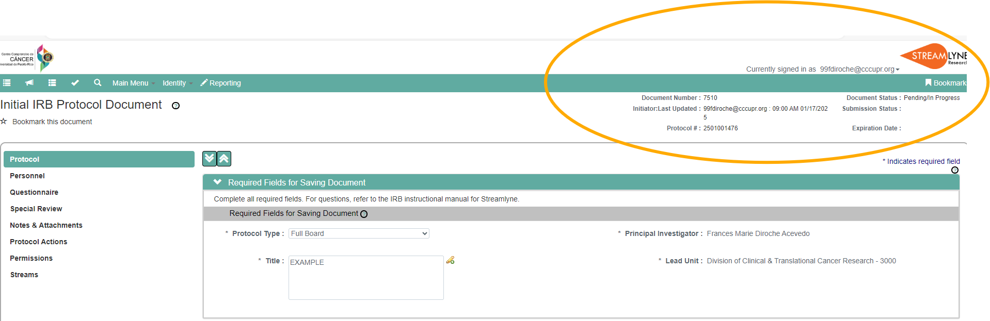
Document Number: Unique 4 digits.
Initiator: Email of the initiator + the last time and date the protocol was accessed.
Protocol #: Last two digits of the current year + two digits of the current month + sequential number.

Slide 14
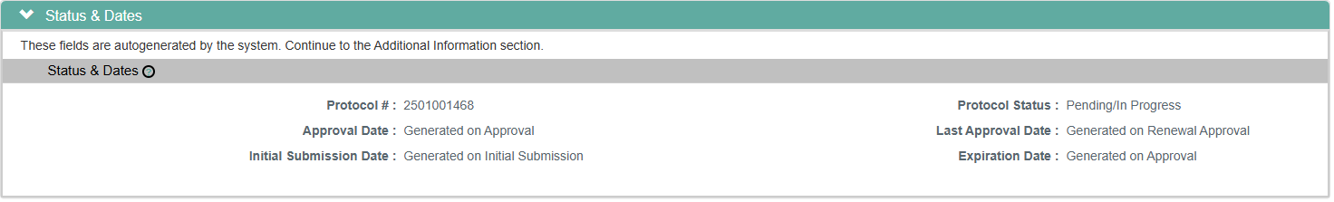
Protocol Tab > Status and Dates
The information is autogenerated by the system. Subsequent dates will be generated based on the actions taken on the protocol.

Slide 15
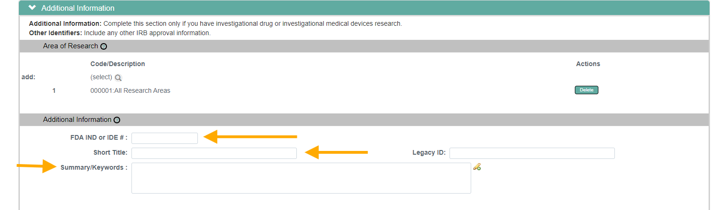
Protocol Tab > Additional Information
FDA Investigational new drug or Investigational device number.
Short title of the Study
Keywords of the Study

Slide 16
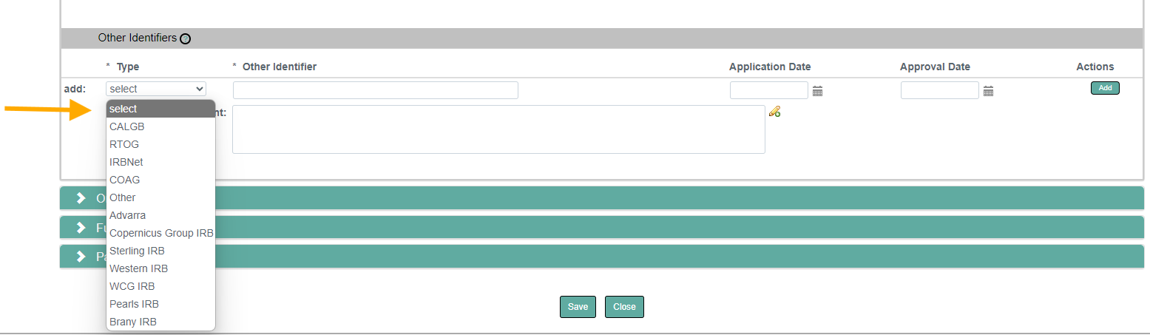
Protocol Tab >Other Identifiers
Select external IRB( if applicable)

Slide 17
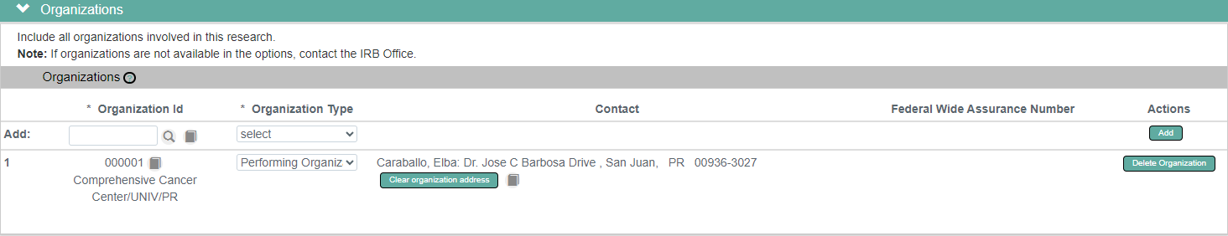

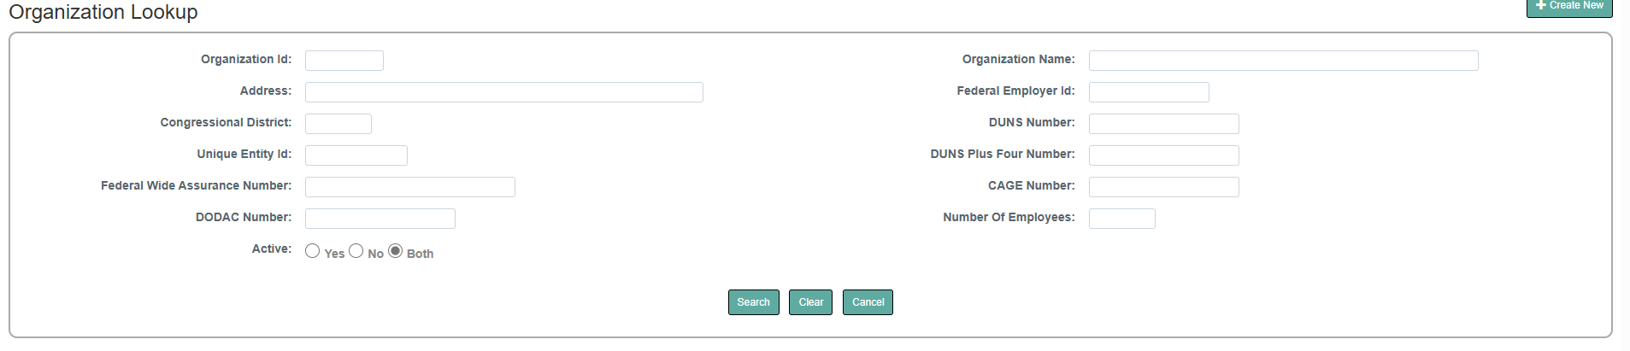
Protocol Tab > Organizations: If the performing organization is external change it.

Slide 18
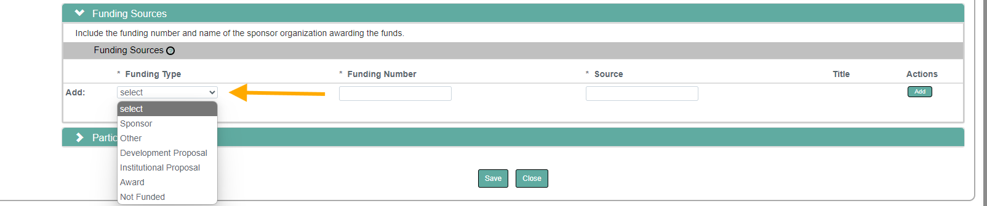
Protocol Tab > Funding Sources: Link the IRB Protocol to your proposal

Slide 19
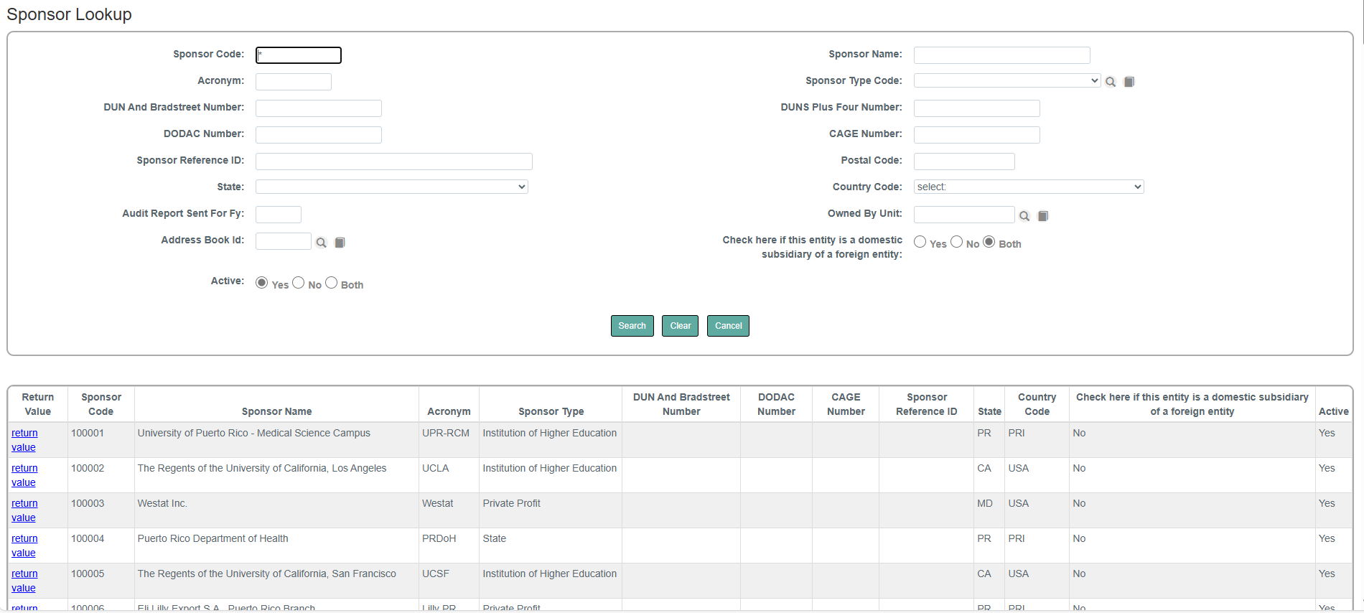
Protocol Tab > Funding Sources: Sponsor

Slide 20
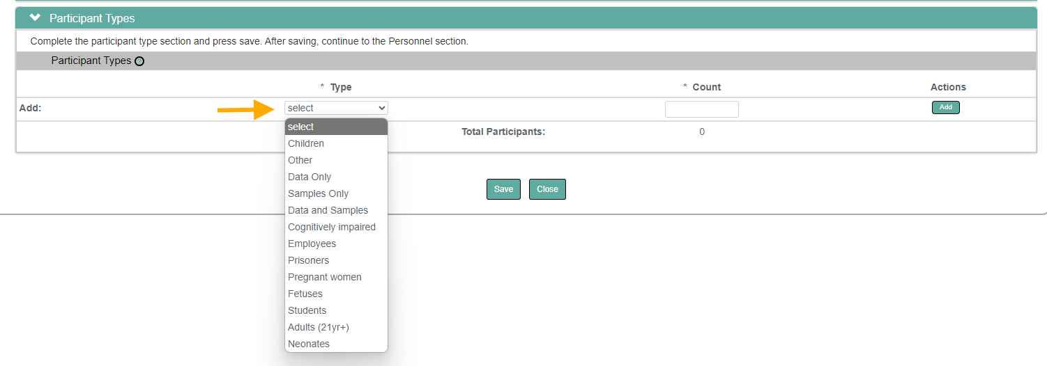
Protocol Tab > Participants Types
Add the type of participants according to their category individually, along with an approximate count.

Slide 21
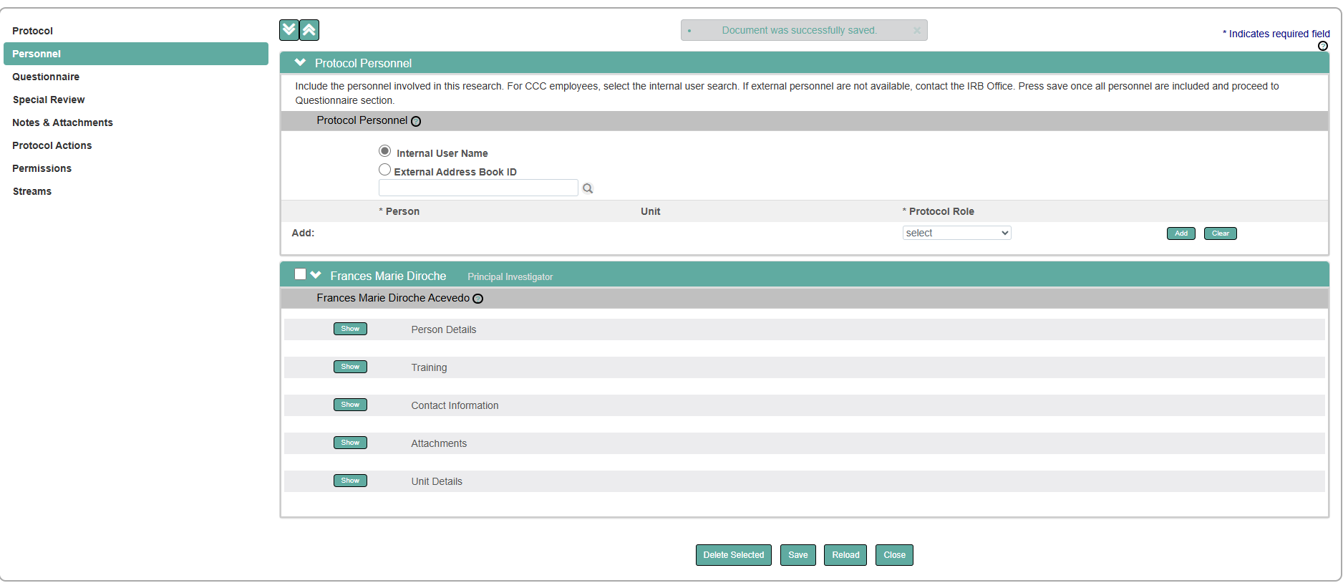
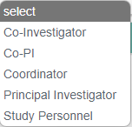
Personnel Tab> Protocol Personnel
Search and add personnel

Slide 22
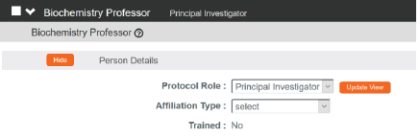
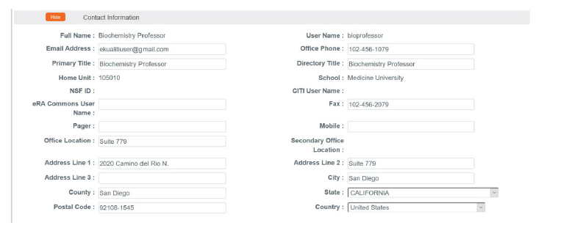
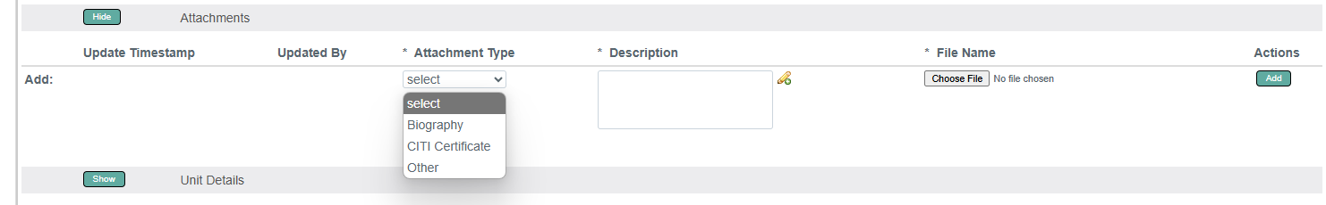
Update the Affiliation type
Contact information is already in the system but can be updated.
Attach each file individually
No special characters in the file name
Description: file name + personnel name and last name

Slide 23
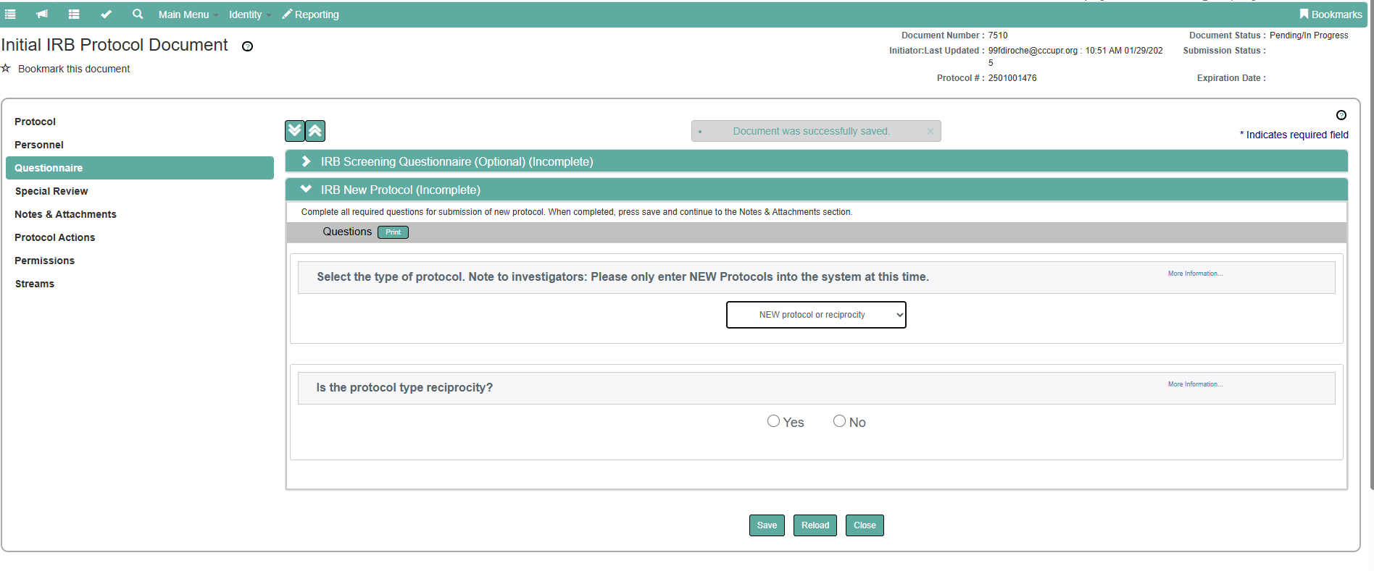
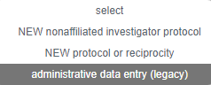
Questionnaire Tab
Answer the questions and include notes and attachments when requested.

Slide 24
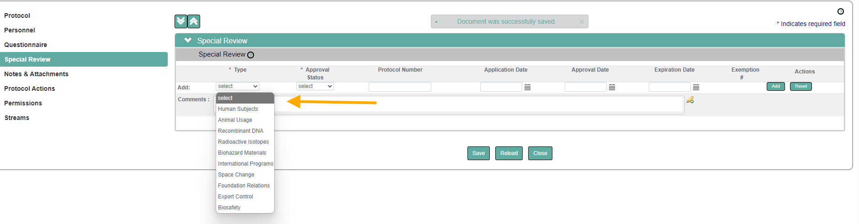
Special Review Tab
Add special reviews linked to your protocol
Include additional special reviews associated with your IRB protocol, such as biosafety, IACUC, biohazard materials, etc. (excluding human subjects)
Notes:
Si

Slide 25
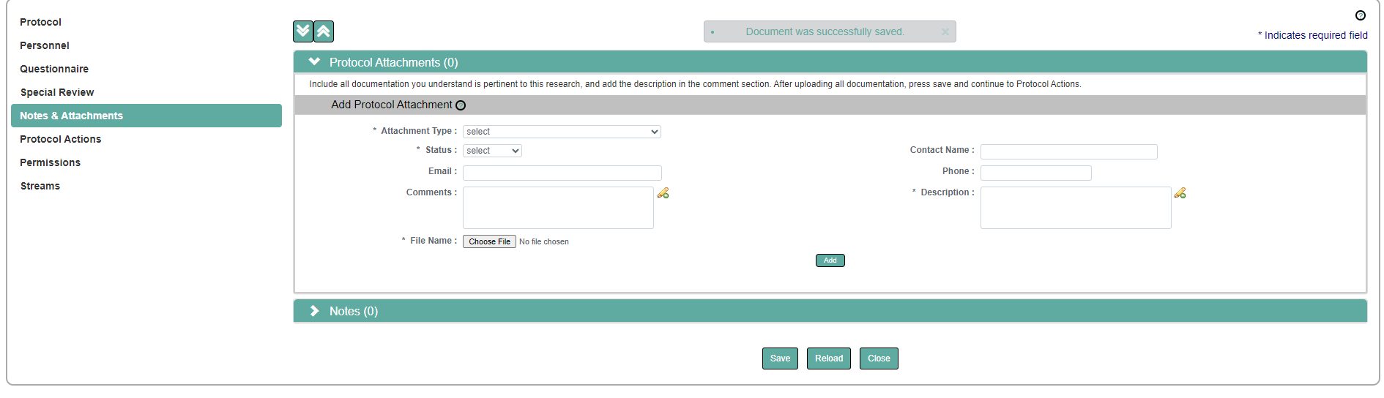
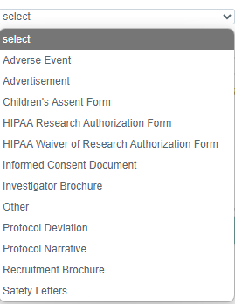
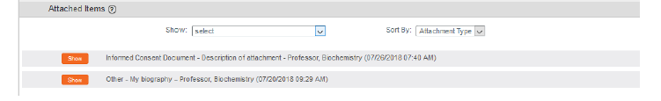
Notes and Attachments Tab
Complete these 3 required fields
Complete or incomplete
Don’t include special characters in the file name. The System does not recognize it.
Upload each document individually.

Slide 26
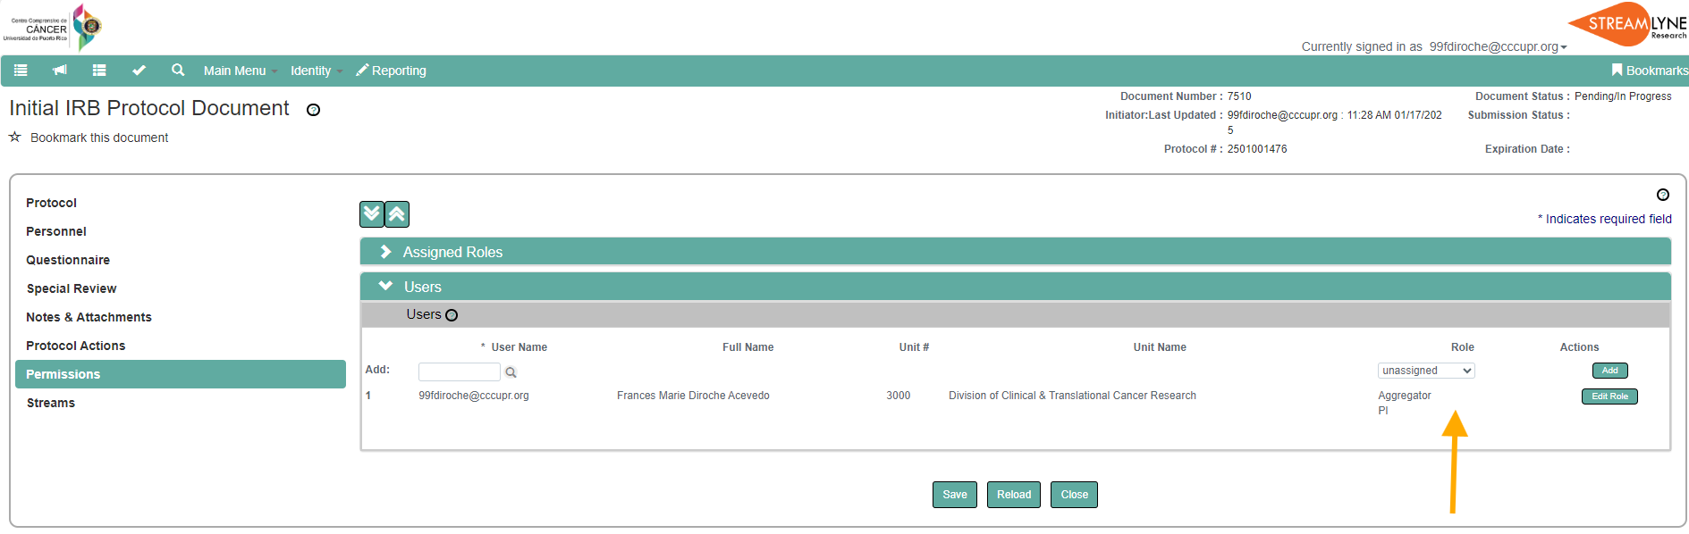
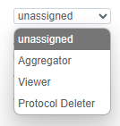
Permissions Tab> Users
Only the Principal Investigator (PI) can assign roles to the Study personnel.

Slide 27
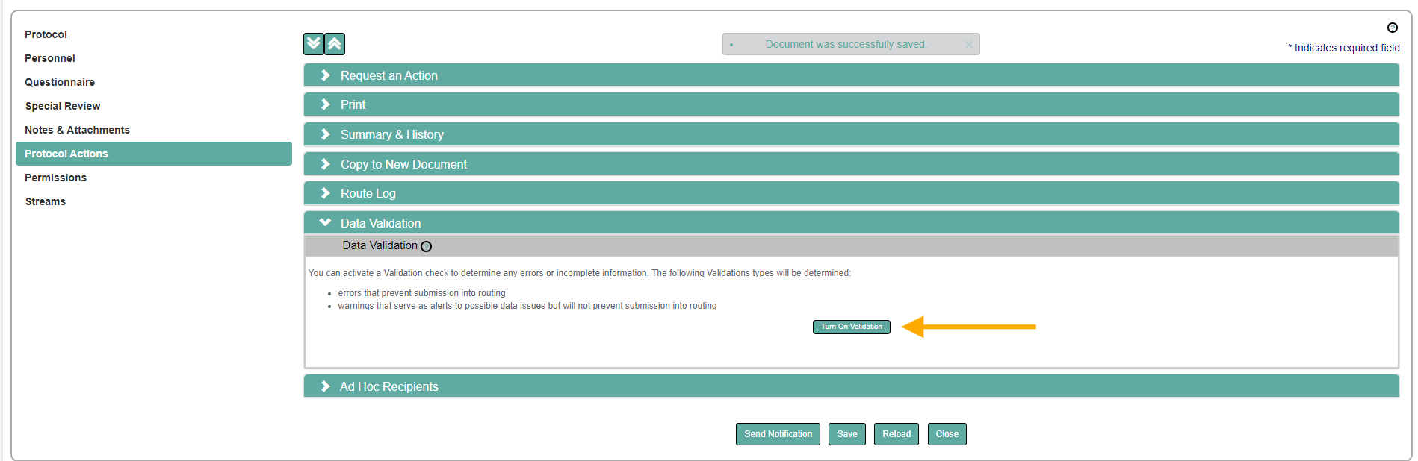
Protocol Actions Tab> Data Validation
Activate to determine any errors or incomplete information.
The system will indicate where the error is located. Click the 'Fix' button, and it will direct you to the section containing the error

Slide 28
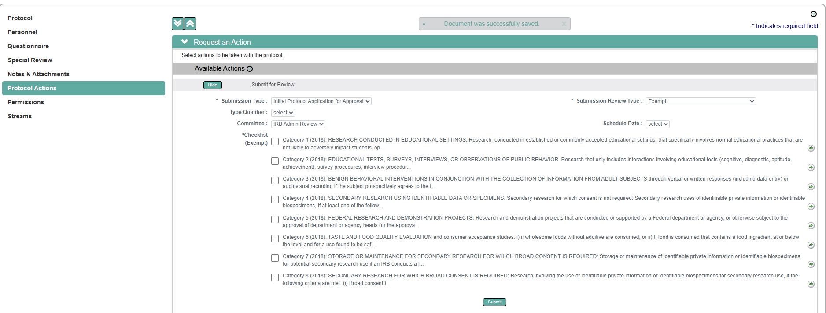

Protocol Actions> Request an Action> Submit Protocol for Review
Complete these required fields
If the protocol is exempt or expedited a checklist will display.

Slide 29
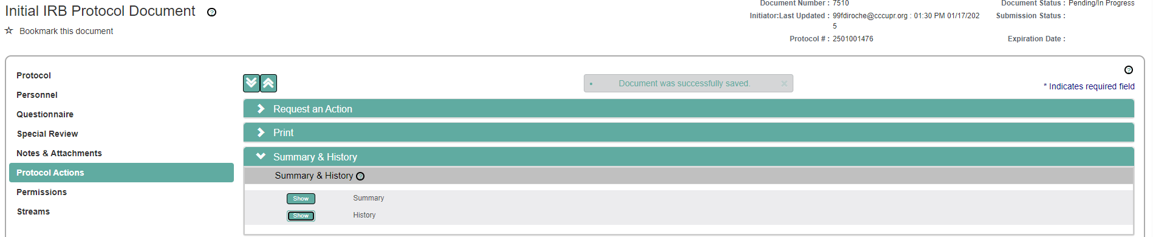
Protocol Actions> Summary and History
key identifying information about the Protocol document including key dates, personnel, status, type, area of research, attachments, funding sources, participant types, organizations involved, and special review information.
Protocol submission, its reviewers, vote summary, check list items, and review comments.
Notes:
Repeat for each file

Slide 30
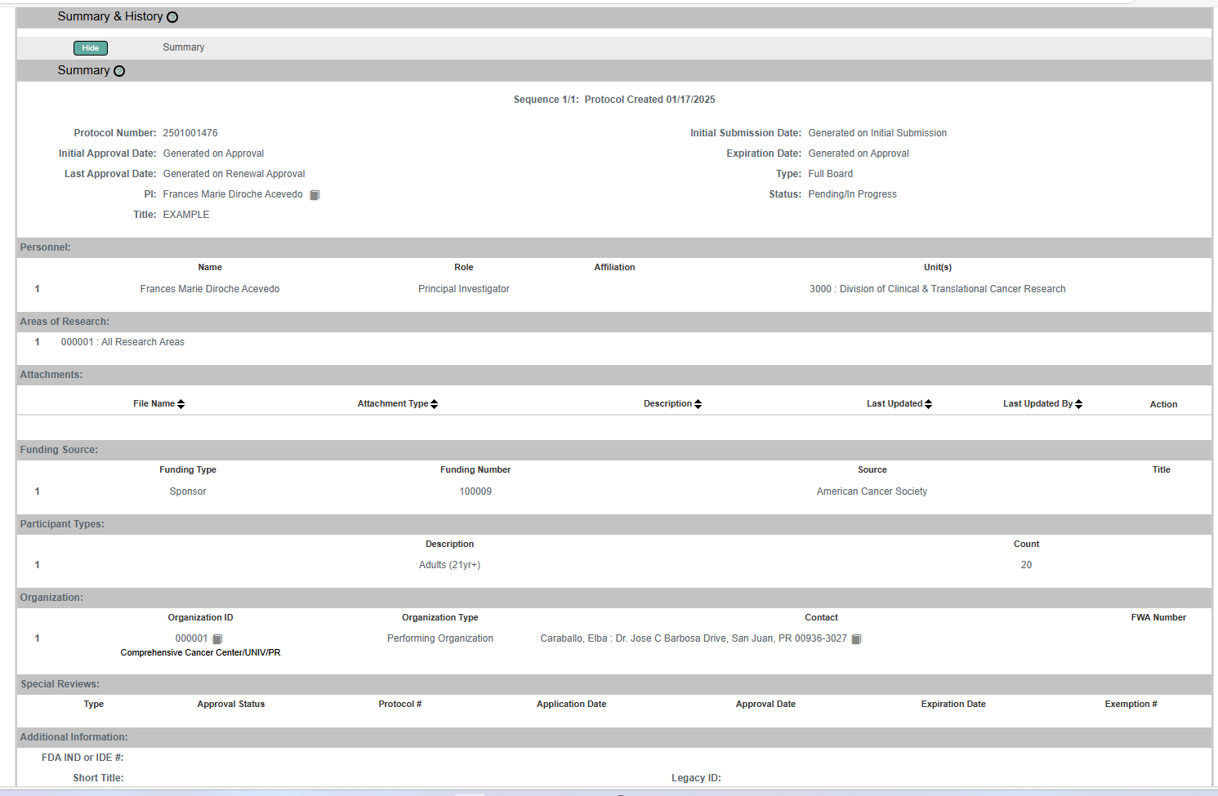
Protocol Actions> Summary
Notes:
Repeat for each file

Slide 31
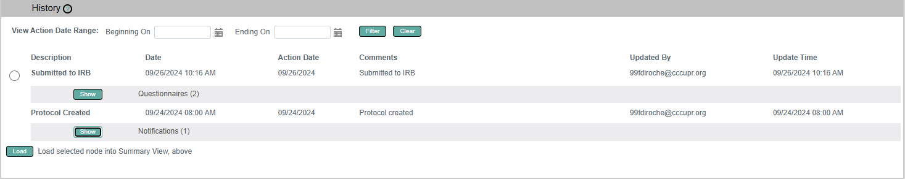
Protocol Actions> History
Notes:
Repeat for each file

Slide 32
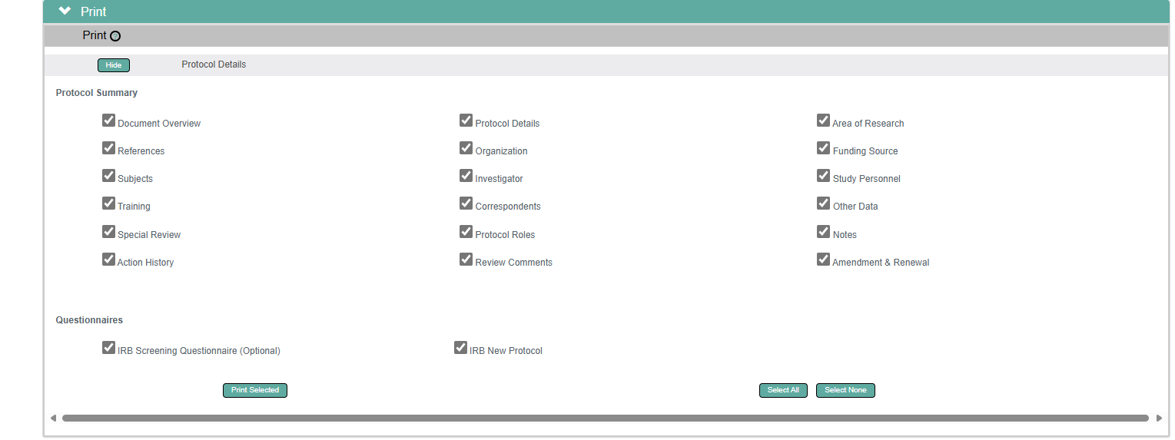
Protocol Actions> Print
The entire protocol can be printed, or you can choose to print it by sections

Slide 33
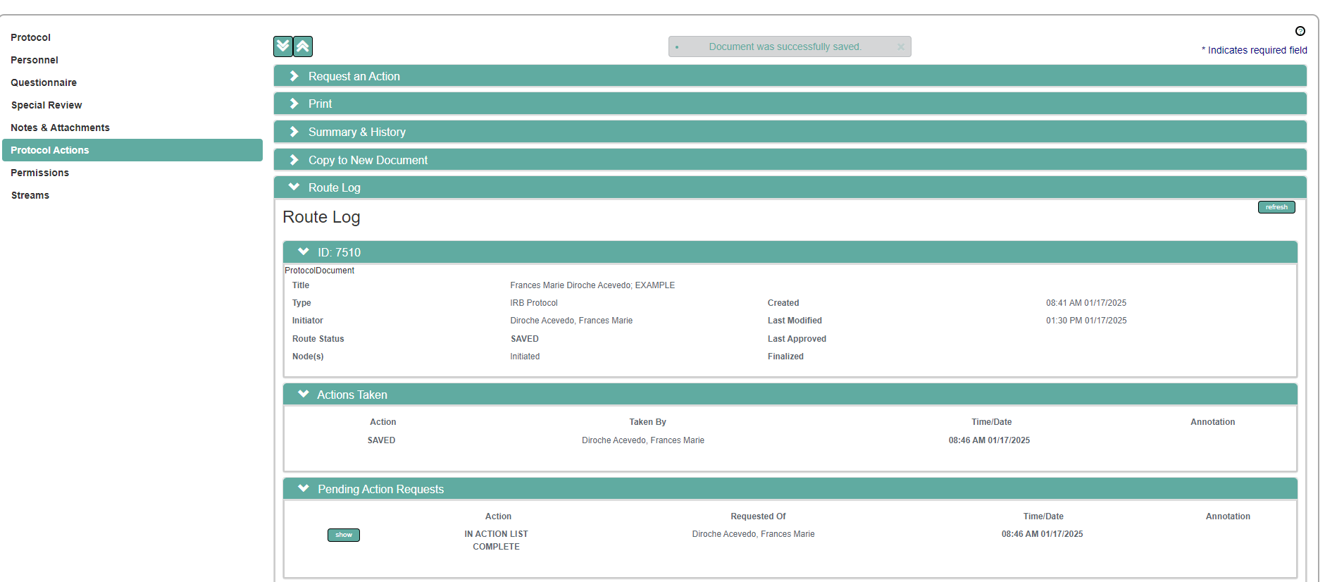
Protocol Actions> Route Log
Route log provides a detailed record of the approval process for a protocol
Notes:
Repeat for each file

Slide 34
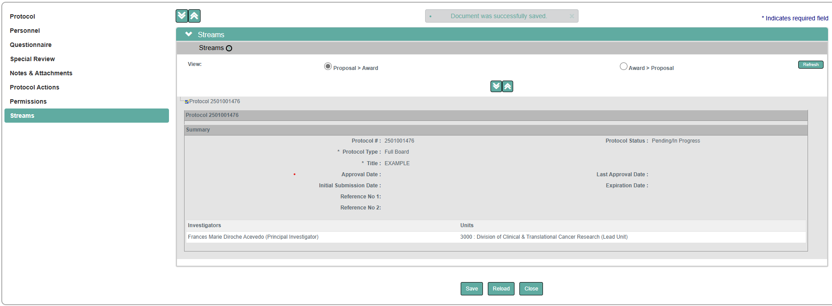
Streams Tab
The Streams tab gathers and displays details of all other documents linked to a specific protocol.

Slide 35
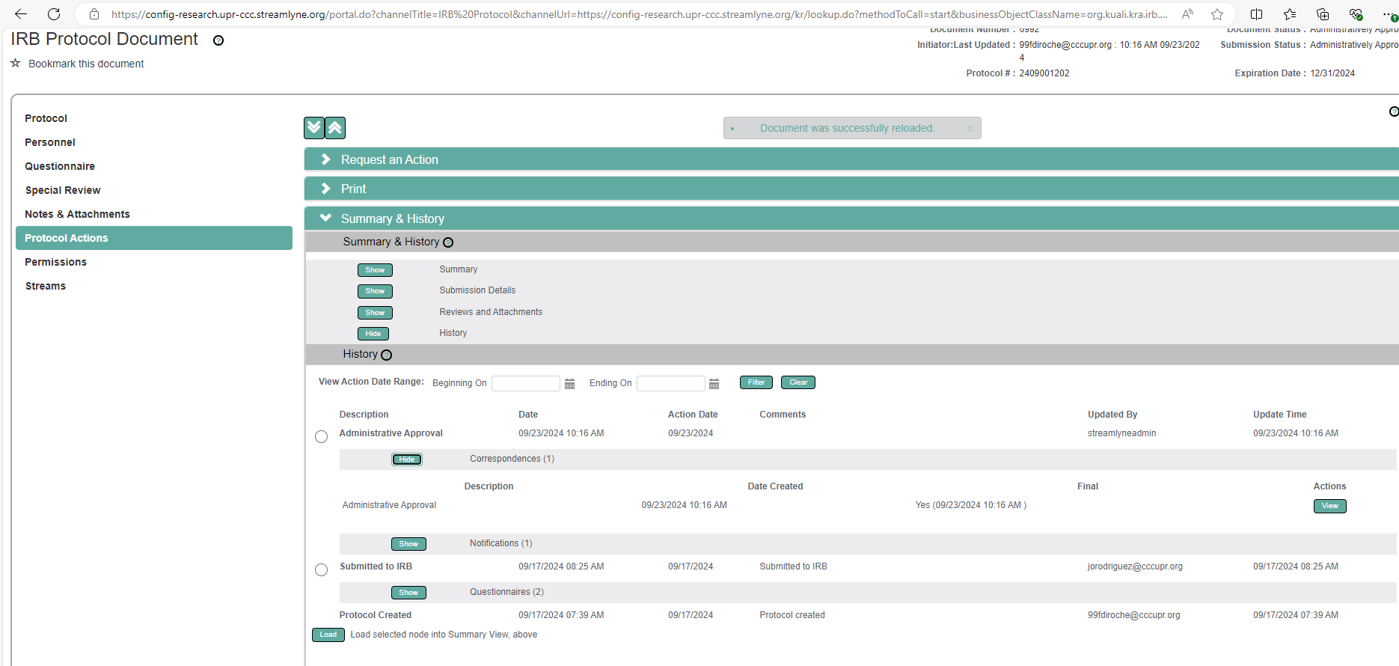
IRB Approval Letter
Protocol Actions> Summary and History> History

Slide 36
Available Actions after Initial submission

Slide 37


Delete a Protocol
Protocol must be editable.
Protocol status must be Pending/In Progress, Amendment in Progress, Renewal in Progress, or Withdrawn.
PI will no longer have access to the protocol.
Result: The Protocol Status will be updated to Deleted.
Notes:
Action can only be performed before submitting the protocol

Slide 38
Recall Protocol
This refers to the process of pulling back a submission that has already been sent for review or approval. It allows the submitter to make necessary changes or corrections before resubmitting it.

Slide 39


Withdraw a Protocol
Protocol that has reached the IRB Administrator for review and approval, but the investigator no longer wish to have it reviewed.
Notes:
Repeat for each file

Slide 40


Editing a returned Protocol: PI will get a notification and two items on the Action List
PI will get a FYI notification, and the Protocol for editing.
A protocol can be returned due to errors, incomplete information, or required revisions.

Slide 41

Accessing review comments
Notes:
Repeat for each file

Slide 42



Accessing Correspondence
PI will be able to download the official correspondence.
Notes:
Repeat for each file

Slide 43

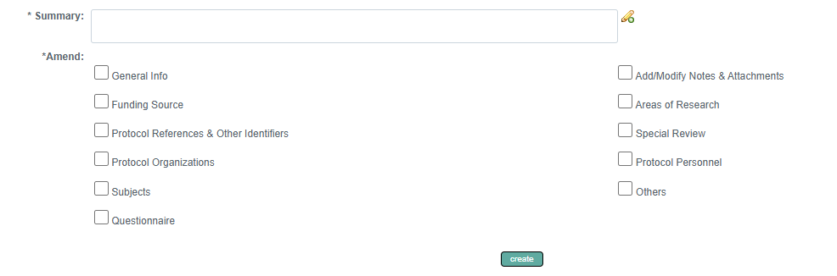
Creating & Submitting an Amendment
If the study is not new, it is important to indicate the actual amendment number in the summary.
An amendment questionnaire will be generated by the system.(Required)
Protocol #1802003135A001

Slide 44
Modify Amendment Sections
Submit document for review after update
Notes:
Repeat for each file

Slide 45
Creating & Submitting a Renewal
If the study is not new, it is important to indicate the actual Renewal number in the summary.
Protocol #1802003135R001
A Renewal questionnaire will be generated by the system.
Notes:
Repeat for each file

Slide 46
Creating & Submitting a Renewal with Amendment
Protocol Actions > Request an Action > Available Actions

Slide 47
Resubmitting the Protocol

Slide 48
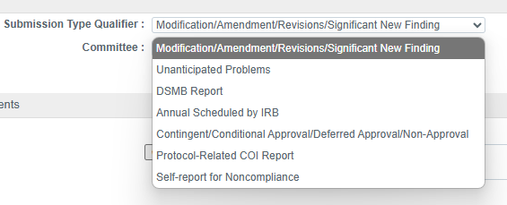
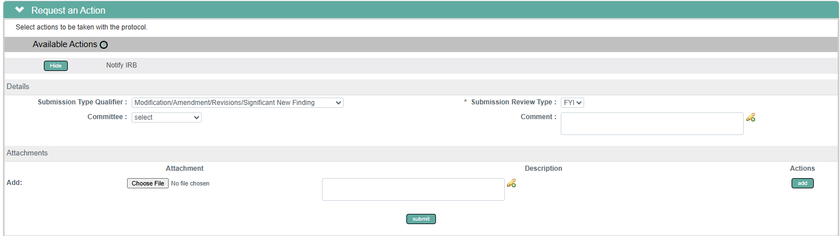
Communicating with the IRB
Protocol Actions > Request an Action > Available Actions> Notify the IRB

Slide 49
Other available actions:
Protocol Actions > Request an Action > Available Actions
Request to close- PI is requesting to close the study.
Request for suspension- Noncompliance, serious adverse events, risk-benefit ratio etc.
Request for Termination- Noncompliance, safety and ethical concerns, lack of funding etc.
Request to close enrollment- PI request to close participants enrollment.
Request to Re- open enrollment- PI request to re-open participants enrollment.
Request for Data analysis only- Study no longer will be recruiting participants nor collecting data. PI request study will be on data analysis only.

Slide 50


